Slide 1

DEEP LEARNING
Image Recognition with Transfer Learning (CIFAR-10 Dataset)
MASTER OF SCIENCE OF INFORMATION SYSTEMS
INTELLIGENT SYSTEMS
STUDENTS (GROUP2) | AINEDEMBE DENIS 2024-M132-23999
 | MUSINGUZI BENSON 2024-M132-23947
LECTURER | Dr. Sibitenda Harriet

Slide 2
Project Objectives
  Apply transfer learning to the CIFAR-10 image classification task
  Compare performance of pre-trained models and a custom CNN
  Implement preprocessing, upsampling, and augmentation techniques
  Analyze training outputs and model behavior

Slide 3
About the CIFAR-10 Dataset
  CIFAR-10 contains 60,000 color images sized 32×32 pixels.
  10 mutually exclusive classes, with 6,000 images per class.
  Split: 50,000 training images and 10,000 test images.
  Dataset structure: 5 training batches (10,000 each) and 1 test batch.
  Test batch has exactly 1,000 images per class.
  Training batches contain 5,000 images per class in total (random distribution).
  Each batch is a pickled Python dictionary containing 'data' and 'labels'

Slide 4
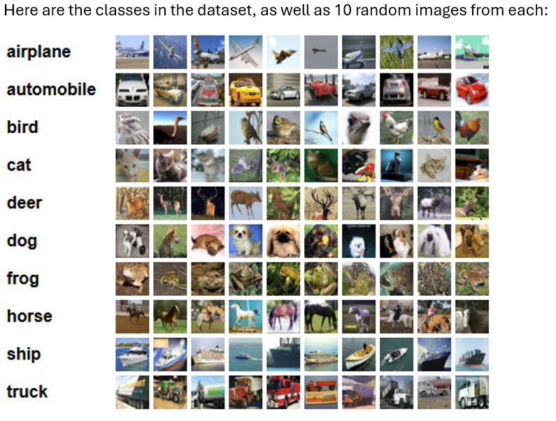
About the CIFAR-10 Dataset

Slide 5
Real-Life Applicability
  1. Automated Image Classification
  Used in photo apps, digital libraries, and content filtering
  Helps systems recognize and sort images automatically
  2. Object Detection Pre-Training
  CIFAR-10 teaches models to detect basic objects
  Useful for self-driving cars, surveillance, and drone vision
  3. Transfer Learning for Real Datasets
  Same method used in medical imaging (X-ray/MRI)
  Also applied in face recognition and other advanced AI systems

Slide 6
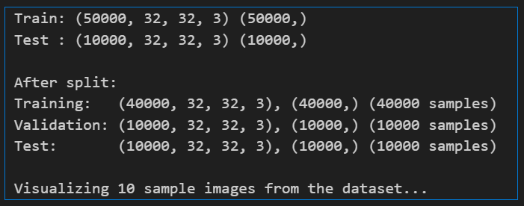
Load CIFAR-10 datase

Slide 7
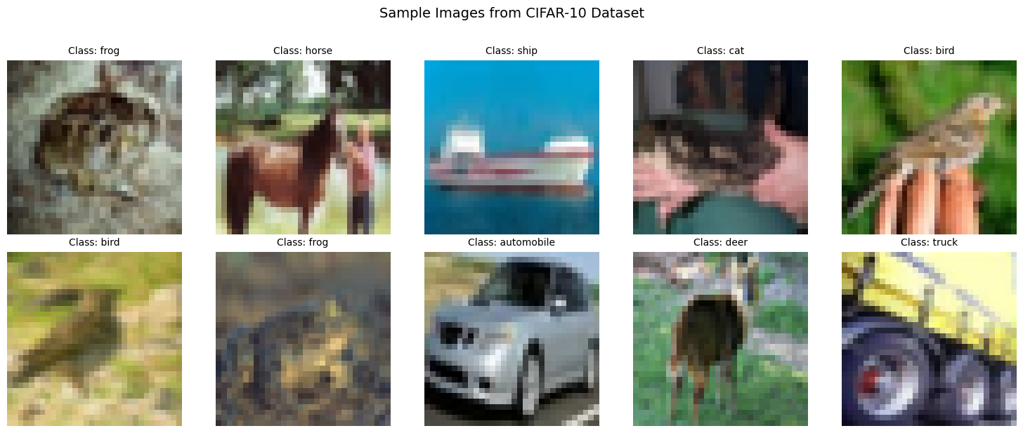
Visualize sample images from each class

Slide 8
  Pre-trained model Used MobileNetV2

Slide 9
Data augmentation - Applying rotation, flipping, and shifts
BATCH_SIZE = 128:
Number of samples processed together in one training step
With 40,000 training images and batch size 128, you get ~313 batches per epoch (40,000 ÷ 128)
Target image dimensions for MobileNetV2 input =96
CIFAR-10 images are 32x32, but MobileNetV2 expects larger images
96x96 is a good size: larger than 32x32 but smaller than standard 224x224
Data augmentation - Apply rotation, flipping, and shifts
Random rotation (up to 15 degrees ≈ 0.262 radians)
Random horizontal flipping /vertical shifts

Slide 10
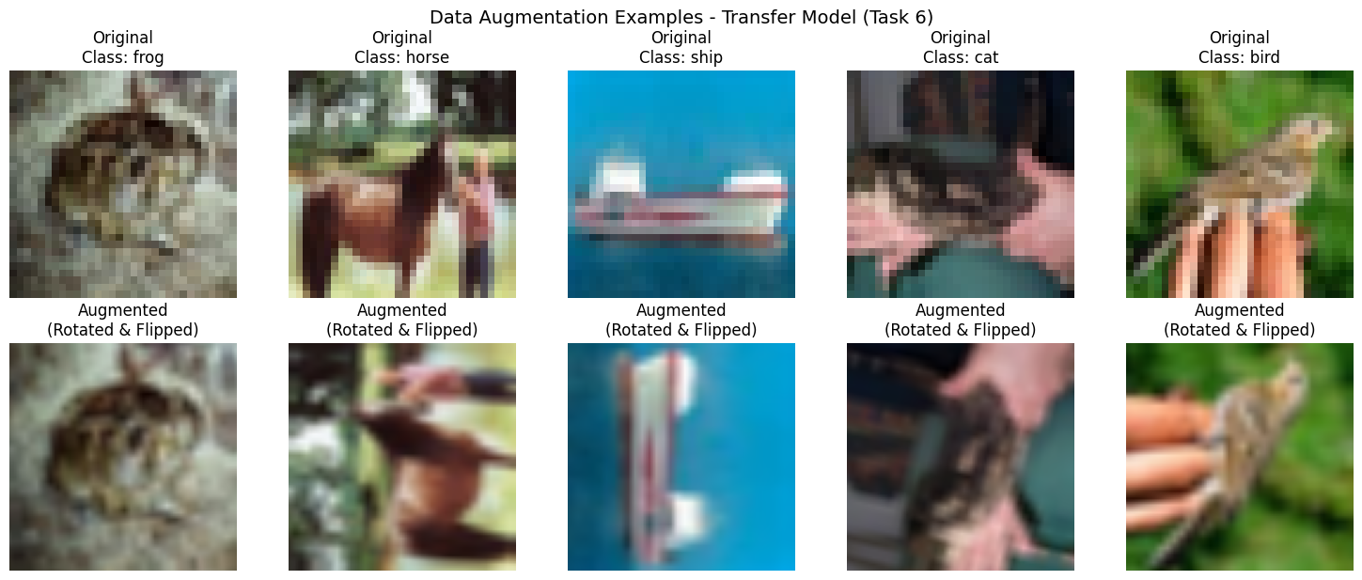
Apply data augmentation (rotation, flipping, shifts)

Slide 11
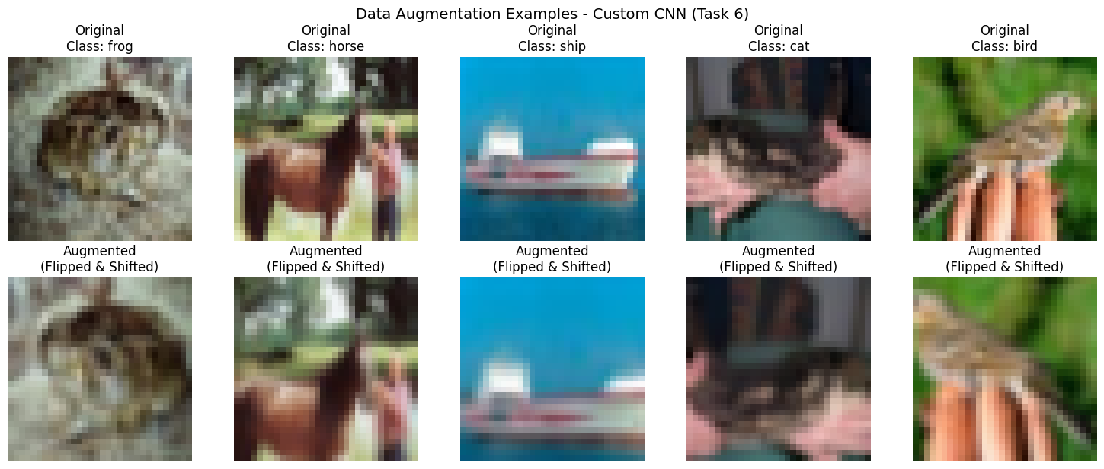
Apply data augmentation (rotation, flipping, shifts)

Slide 12
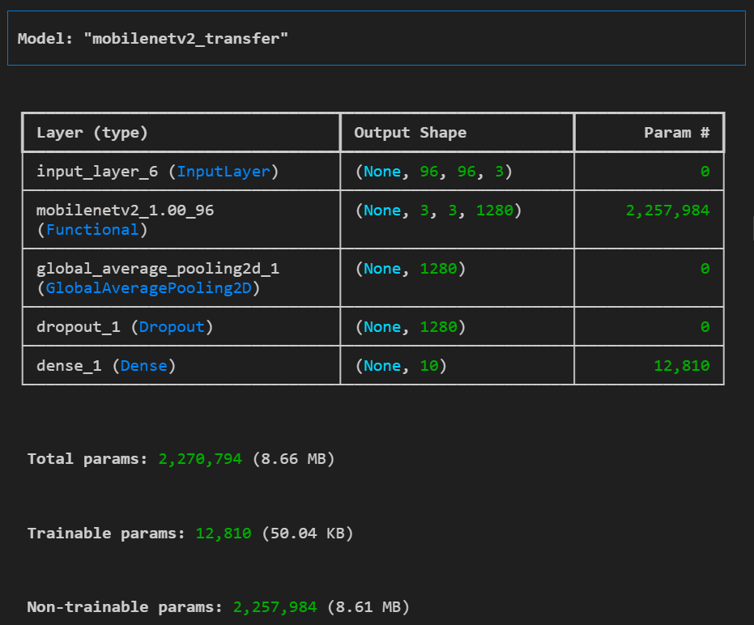
Using pre-trained MobileNetV2 for transfer learning

Slide 13
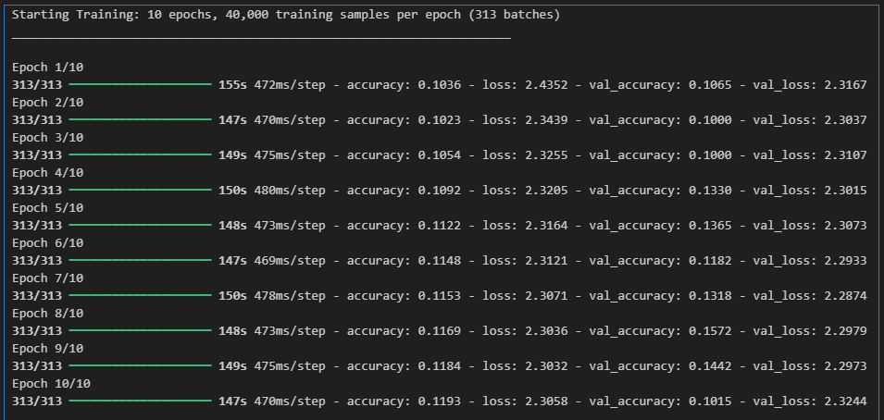
Freeze lower layers, retrain top layers for 10 epochs

Slide 14
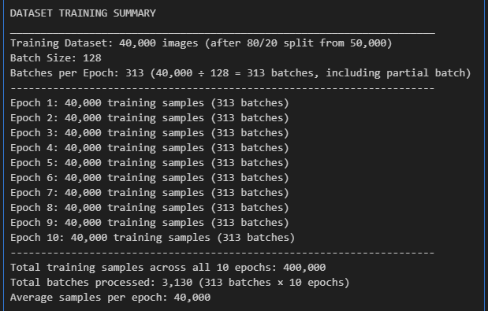
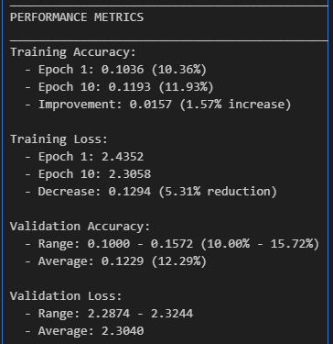
Freeze lower layers, retrain top layers for 10 epochs

Slide 15
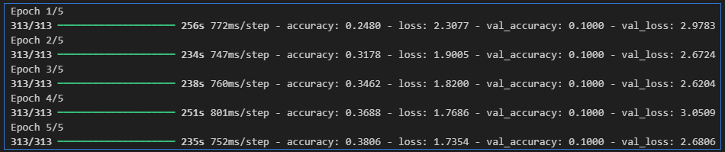
Fine-tuning different layers and learning rates
Fine-tune from this layer onwards
fine_tune_at = 100
EPOCHS_FINE_TUNE = 5

Slide 16
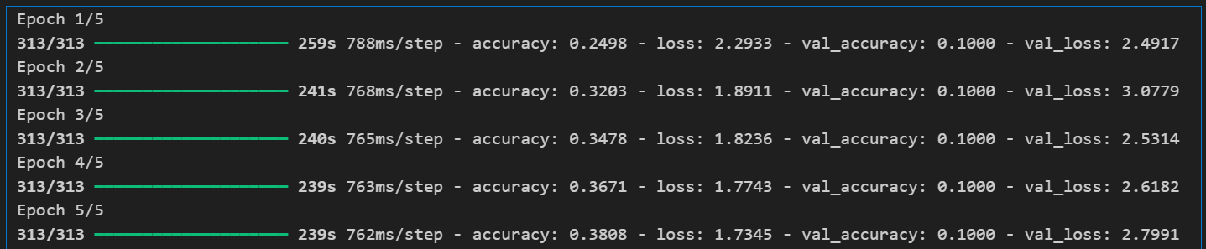
Experimenting with fine-tuning different layers & learning rates
Fine-tune from this layer onwards
Fine Tune at = 100
EPOCHS FINE TUNE = 5

Slide 17
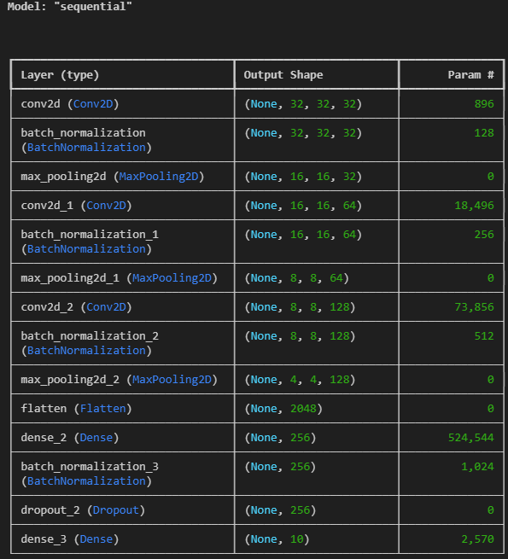
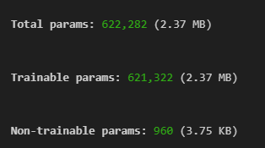
Building custom CNN from scratch for performance comparison

Slide 18
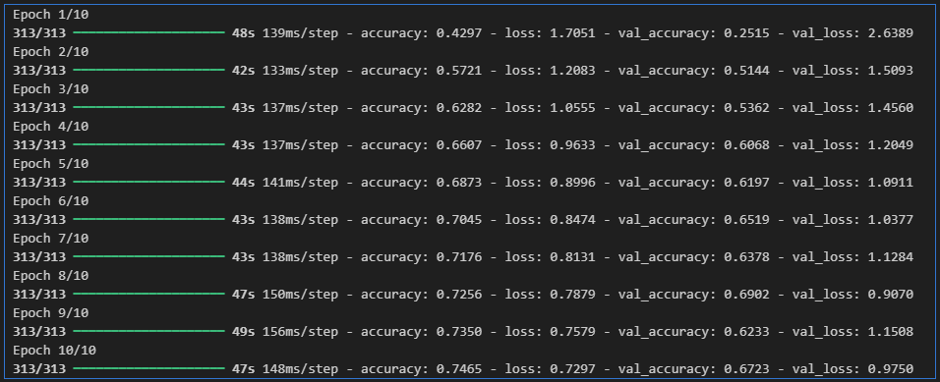
Building custom CNN from scratch for performance comparison

Slide 19
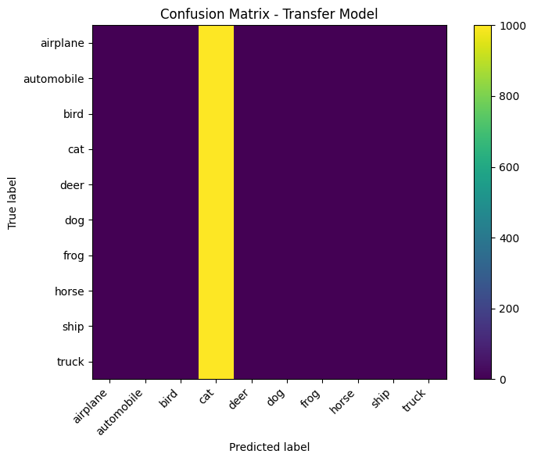

Evaluating accuracy and confusion matrix; visualize predictions
Transfer (fine-tuned) test accuracy: 0.10000000149011612
Custom CNN test accuracy: 0.6708999872207642
79/79 ━━━━ 33s 388ms/step
Confusion matrix shape: (10, 10)

Slide 20
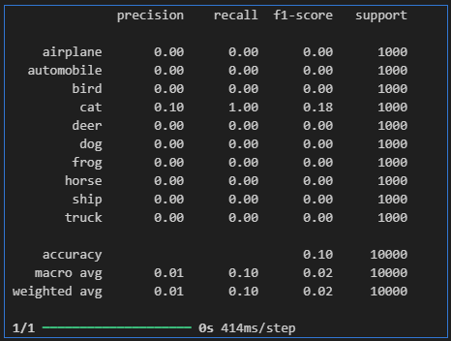
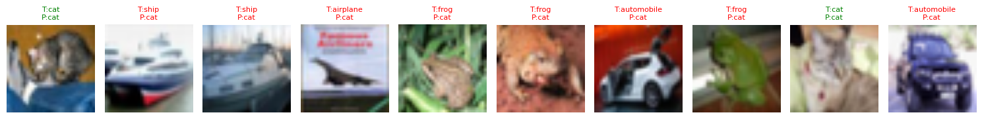
Compare Performance with custom CNN (Continued)
Sample predictions

Slide 21
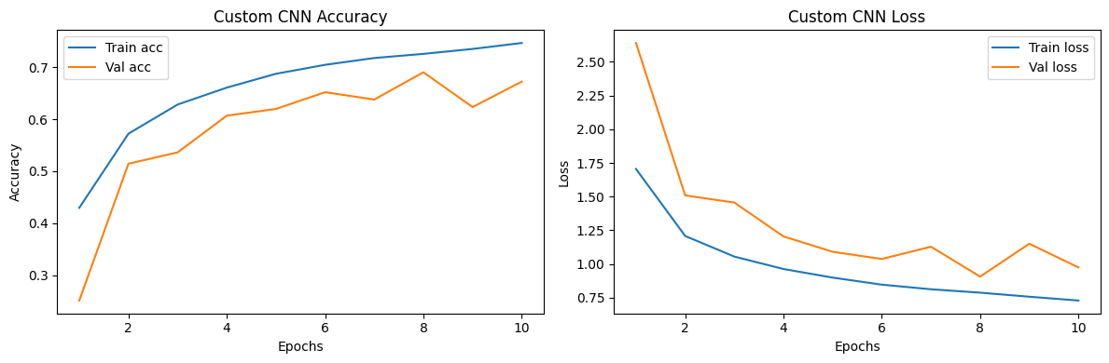
Plot training history (accuracy/loss) for all models
Accuracy:
Training: Starts at ~40%, increases to ~75% by epoch 10
Validation: Starts at ~25%, increases to ~67% by epoch 10
Gap: ~8% difference (training higher)
Loss:
Training: Starts at ~1.7, decreases to <1.0 by epoch 10
Validation: Starts at ~2.5, decreases to ~1.05 by epoch 10
Gap: Validation loss remains higher
Overall: Best performance. Both metrics improve, with moderate overfitting.

Slide 22
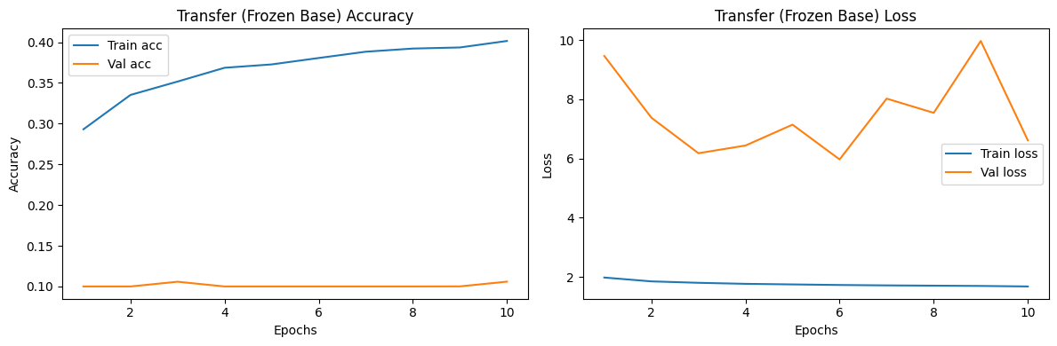
Plot training history (accuracy/loss) for all models
Accuracy:
Training: Starts at ~29%, increases to ~40% by epoch 10
Validation: Stays very low (~10–12%), near random chance
Gap: Large and growing (training ~40% vs validation ~10%)
Loss:
Training: Starts at ~2.0, stabilizes around 1.8–1.9
Validation: Starts at ~9.5, fluctuates between 6–10 with spikes
Gap: Very large (validation loss 3–5x higher)
Overall: Severe overfitting. Training improves but validation does not, indicating poor generalization.

Slide 23
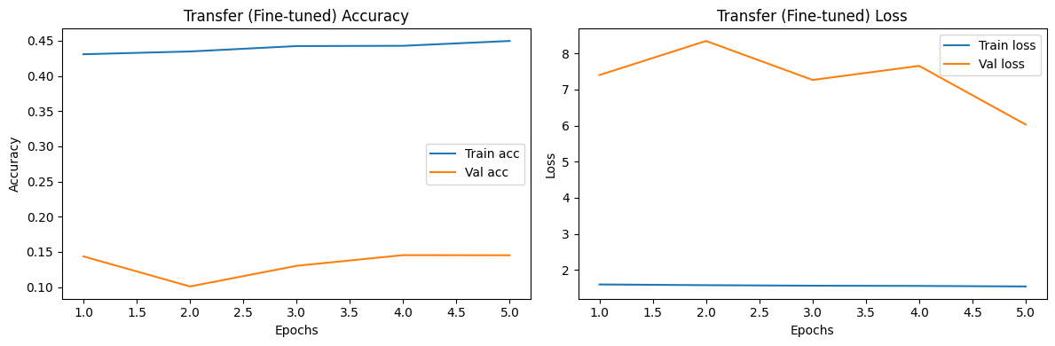
Plot training history (accuracy/loss) for all models
Accuracy:
Training: Starts at ~43%, stabilizes around ~45% by epoch 5
Validation: Starts at ~15%, drops to ~10% at epoch 2, recovers to ~15% by epoch 5
Gap: Very large (~30% difference)
Loss:
Training: Starts at ~1.8, stays stable around 1.7–1.8
Validation: Starts at ~7.5, spikes to >8.0 at epoch 2, decreases to ~6.0 by epoch 5
Gap: Very large (validation loss 3–4x higher)
Overall: Severe overfitting. Fine-tuning did not improve generalization; validation metrics are poor.

Slide 24
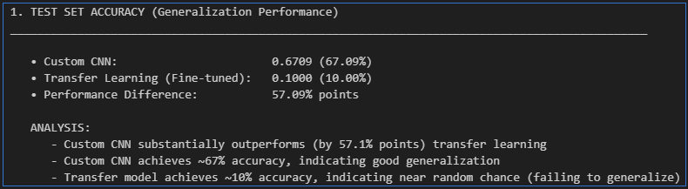
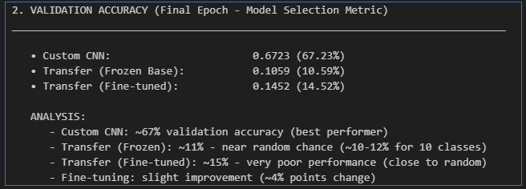
Summary & Discussion
Part 1.1:
Test Set Accuracy
Part 1.2:
Validation Accuracy

Slide 25
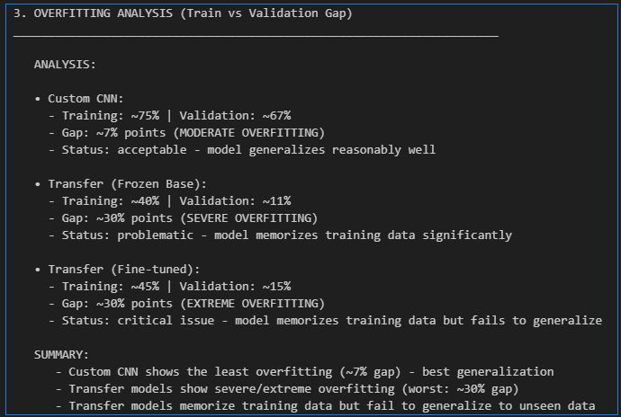
Summary & Discussion
Part 1.3:
Overfitting Analysis

Slide 26
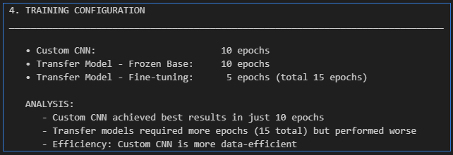
Summary & Discussion
Part 1.4:
Training Configuration

Slide 27
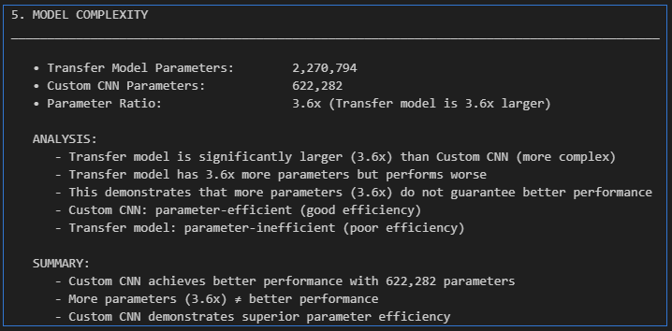
Summary & Discussion

Slide 28
Summary & Discussion

Slide 29
THE END
STUDENTS | AINEDEMBE DENIS +256 788-674576 dembedenisjb@gmail.com, ainedembe.denis@stud.umu.ac.ug
 | MUSINGUZI BENSON +256 782 942245, musiben@gmail.com, musinguzi.benson@stud.umu.ac.ug
LECTURER | Dr. Sibitenda Harriet +256 777 056581 hsibitenda@umu.ac.ug

